Slide 1
PIRE INFORMATION MEETING
August 2014

Slide 2


PIRE: Partnerships for International Research and Education:
OISE-0968369: Bilingualism, mind, and brain:
An interdisciplinary program in cognitive psychology, linguistics,
and cognitive neuroscience
(2010-2015)
Pennsylvania State University
PI: Judith Kroll
Co-PIs: Giuli Dussias
Janet van Hell
Center for Language Science
(http://cls.psu.edu/PIRE)

Slide 3
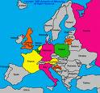
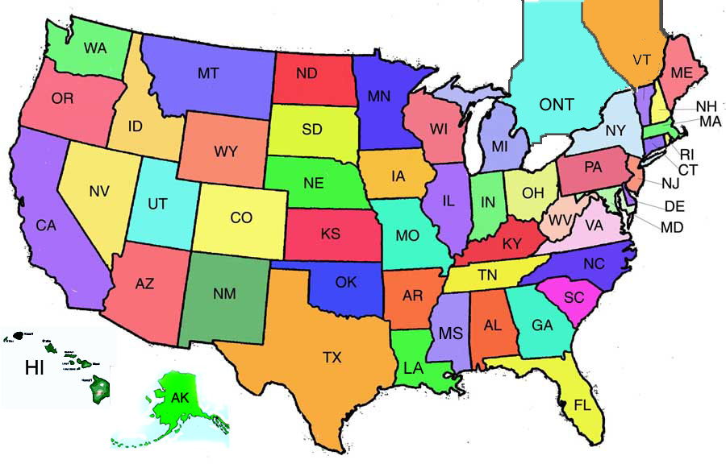
Bilingualism takes different forms in different places and that
requires collaborations here in the US and abroad:

Slide 4
What is PIRE?
PIRE: Partnerships for International Research and Education (National Science Foundation:
http://www.nsf.gov/funding/pgm_summ.jsp?pims_id=12819
Awarded to Penn States’ Center for Language Science in 2010 (through 2015) http://cls.psu.edu/
Our PIRE grant: Bilingualism, mind, and brain: An interdisciplinary program in cognitive psychology, linguistics, and cognitive neuroscience

Slide 5
What is PIRE?
Allows for the creation of international research opportunities for qualified undergraduate students working on language research, who have had research experience with CLS faculty.
8 undergraduate students (U.S. citizens) and 1 undergraduate student (international student in the College of Liberal Arts) will receive funding to conduct innovative research on bilingualism at leading collaborating institutions in Europe and Asia:
Beijing Normal University (Beijing, China)
University of Hong Kong (China)
Mannheim University (Mannheim Germany)
Radboud University (Nijmegen, The Netherlands)
University of Granada (Granada, Spain)
Universitat Rovira i Virgili (Tarragona, Spain)
Bangor University (Wales, UK)
Lund University (Lund, Sweden)

Slide 6
What does a PIRE fellowship cover?
All expense-paid trip (expenses cannot exceed the PIRE budgeted amounts):
Airfare
Lodging
Meals and incidentals
Research expenses
Summer tuition (more on this later)

Slide 7
Who can apply?
U.S. and non-U.S.citizens (the latter must be in the College of the Liberal Arts)
Must conduct research for the proposed summer research experience that fits with the goals of the CLS PIRE project
Must have completed research experience with a CLS research faculty member for at least one year prior to summer travel

Slide 8
Who can apply?
Students can apply during the time they are completing the research experience
In other words, students who plan to enroll in research credits with CLS faculty in Fall 2014 and Spring 2015 are eligible to apply

Slide 9
Who can apply?
Students who currently do not have research experience can prepare themselves for eligibility by enrolling in research credits with a CLS faculty member starting in Fall 2014
and continuing in Spring 2015

Slide 10
Who can apply?
Eligible students will have at least once semester in residence remaining at PSU after returning from the summer abroad research experience (i.e., students in their senior year are not eligible to apply)

Slide 11
What are PIRE fellows expected to do?
Enroll in 6 credits of LING 496 during the summer of travel abroad
Enroll in 3 research credits with their CLS advisor during the returning in- residence semester (i.e. Fall 2015 for students traveling during Summer 2015) to complete their project and present their work at the CLS.
Attend the CLS meetings, which are held every Friday morning from 9:00 to 10:30 in Moore 127.

Slide 12
How do you apply?
Completed application form. A copy of the application form can be directly downloaded from http://cls.psu.edu/pire/pire_faq.html.
Questions about the application process should be directed to your PIRE faculty advisor. You can also write to Sharon Elder at pireundergrads@gmail.com
Copy of your Curriculum Vitae
A letter of recommendation from the CLS faculty research advisor. The letter of recommendation and application materials must be sent directly to Sharon Elder at pireundergrads@gmail.com

Slide 13
When are applications due?
Applications are due Friday December 05st, 2014
Applications must be sent by email to Sharon Elder at pireundergrads@gmail.com.

Slide 14
PIRE Faculty
Communication, Sciences & Disorders Psychology
Carol Miller Michele Diaz
Judy Kroll
French Ping Li
Marc Authier Janet van Hell
Lisa Reed Dan Weiss
Spanish
German Matt Carlson
Carrie Jackson Giuli Dussias
Mike Putnam John Lipski
Richard Page Karen Miller
Marianna Nadeu
Linguistics Rena Torres Cacoullos
Eleonora Rossi

Slide 15
Visit the PIRE Website!
http://cls.psu.edu/PIRE/

Slide 16
Questions?

